Slide 1
Rapid Update Cycle Archive Image Samples
Christopher Herbster
Mike Masscotte
Rob Haley
ERAU

Slide 2
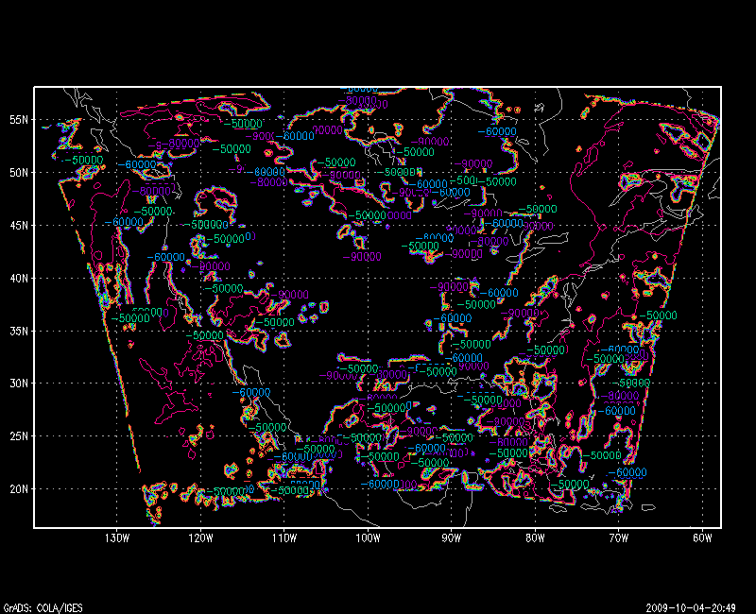
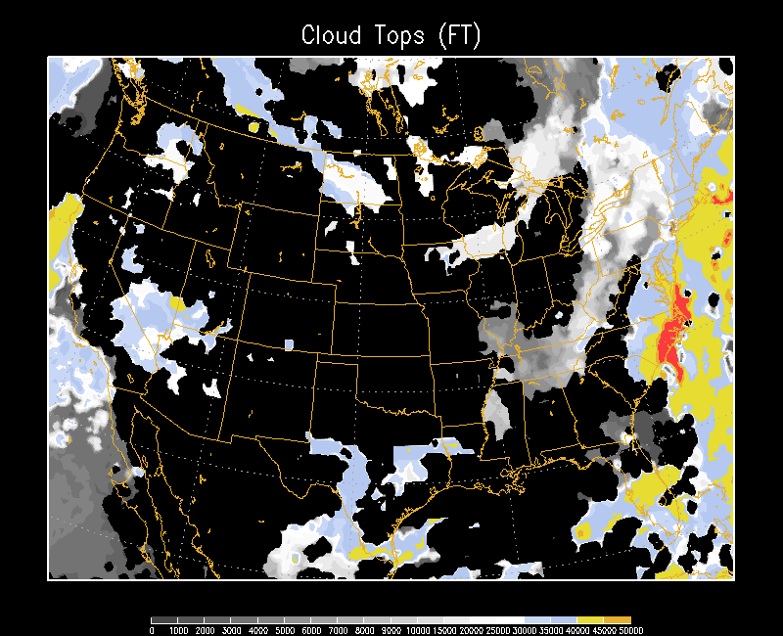
Cloud Tops
Before
After

Slide 3
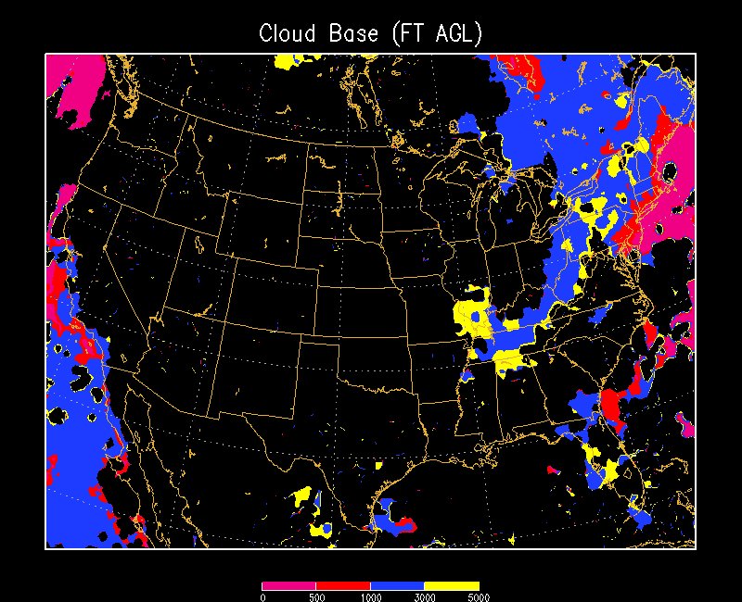
Cloud Base

Slide 4
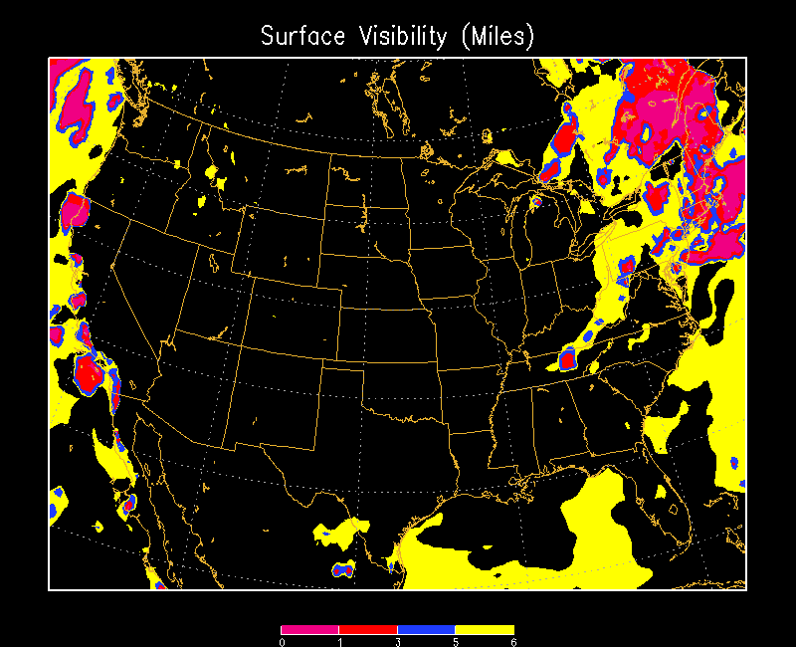
Surface Visibility

Slide 5
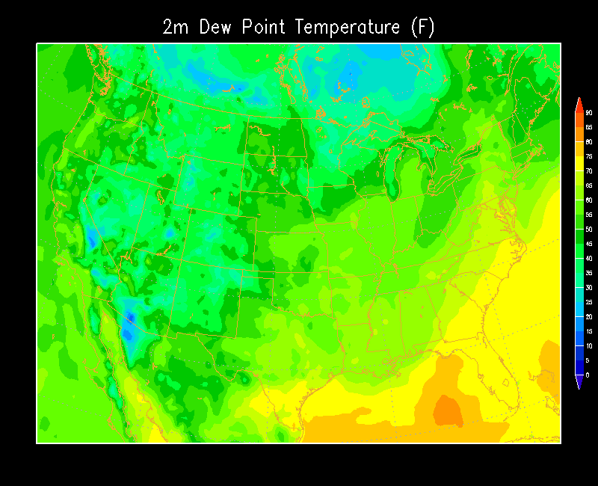
Dew Point

Slide 6
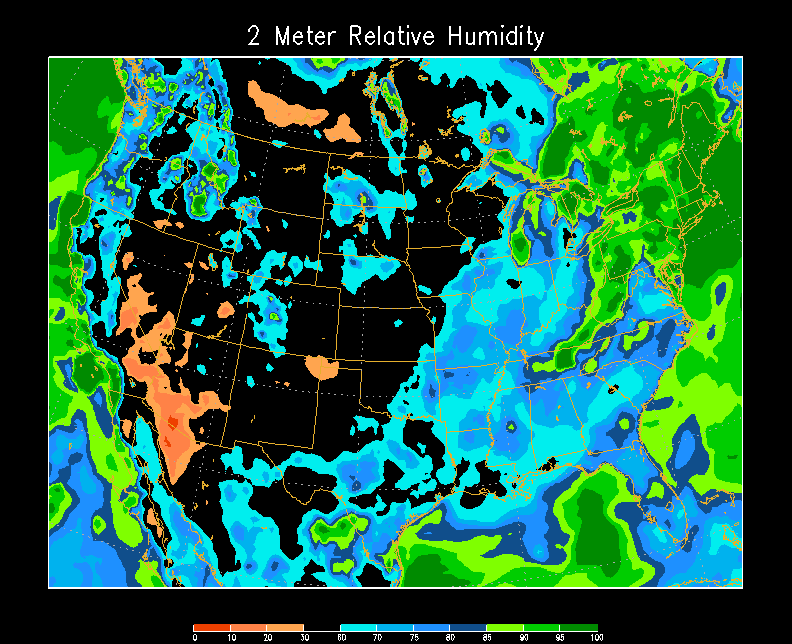
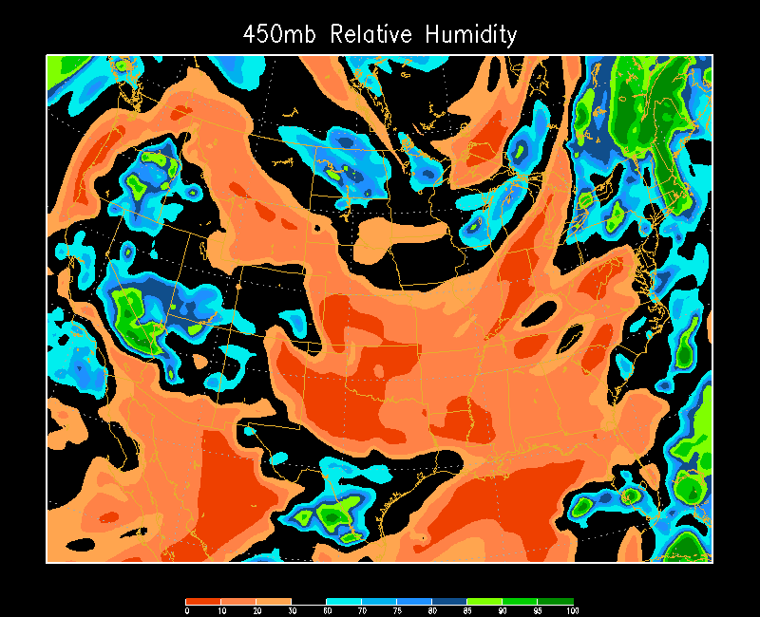
Relative Humidity
Two Meter
450 Millibar

Slide 7
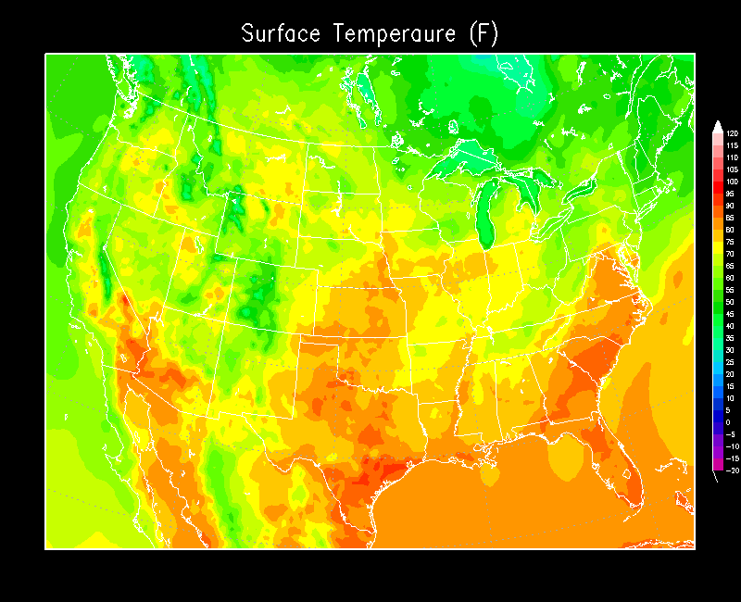
Temperature

Slide 8
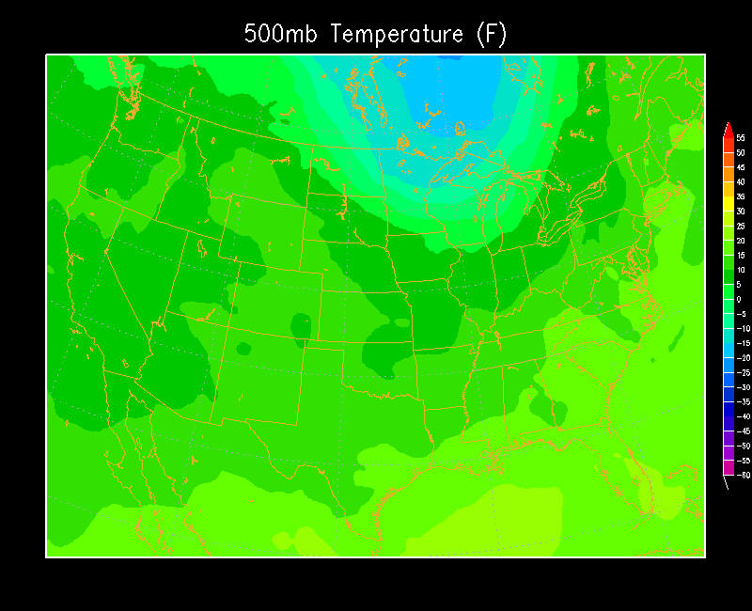
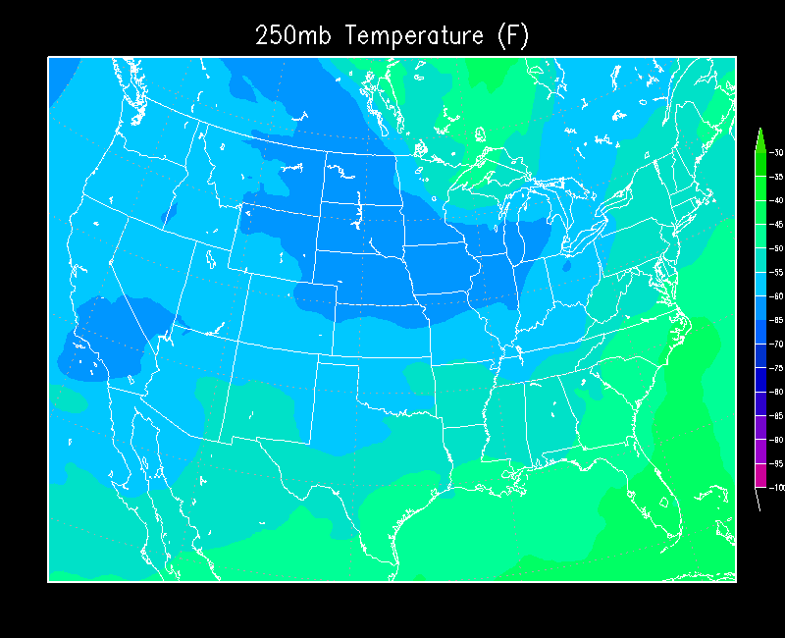
Temperature
500 Millibar
250 Millibar

Slide 9
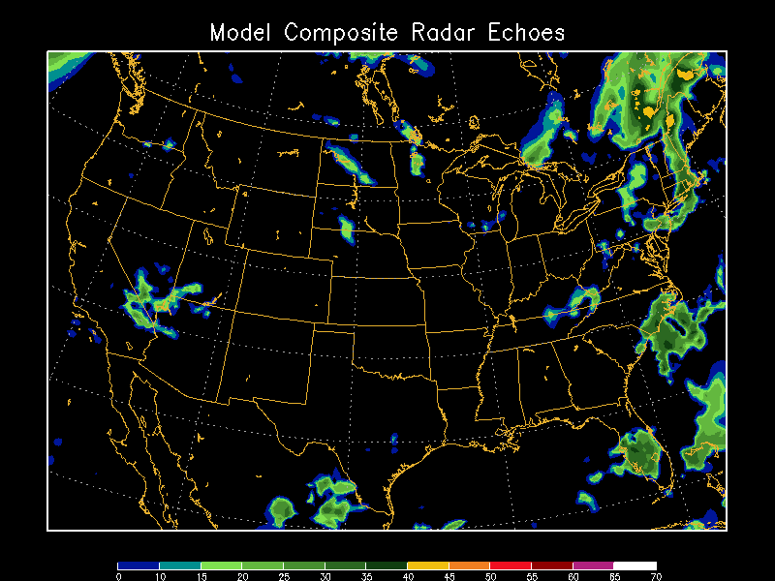
RUC Forecast Radar

Slide 10
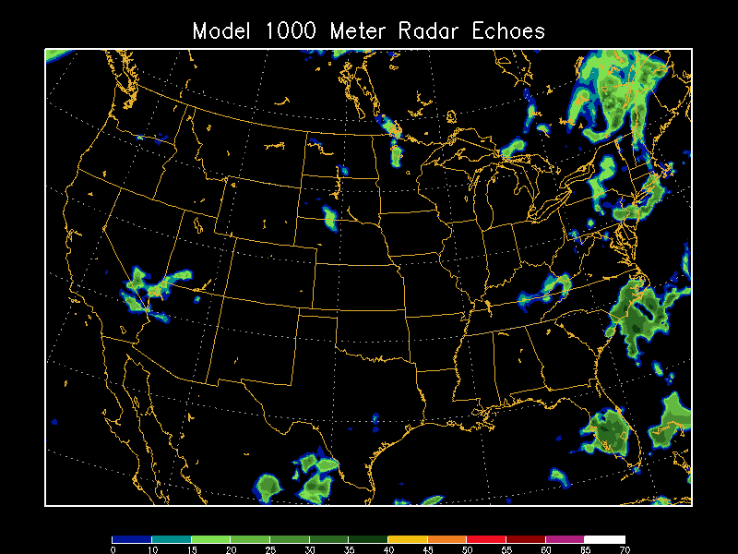
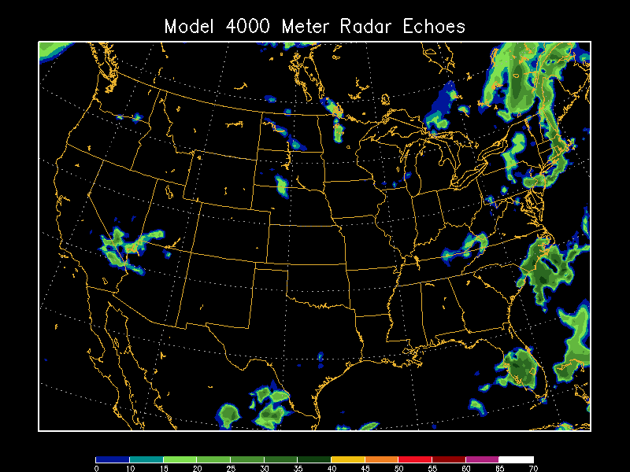
RUC Forecast Radar
1000 Meter (3,280 Feet)
4000 Meter (13,100 Feet)

Slide 11
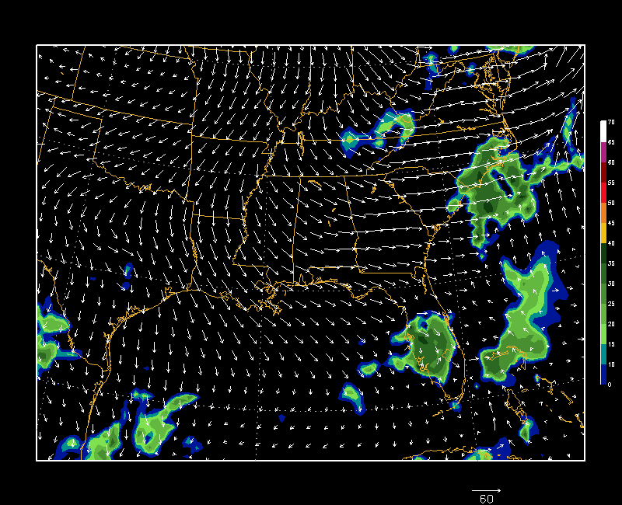
Regional RUC Forecast Radar and Storm Motion

Slide 12
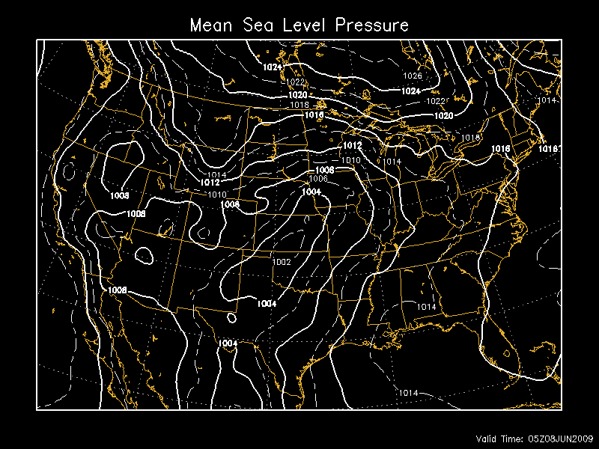
Mean Sea Level Pressure

Slide 13
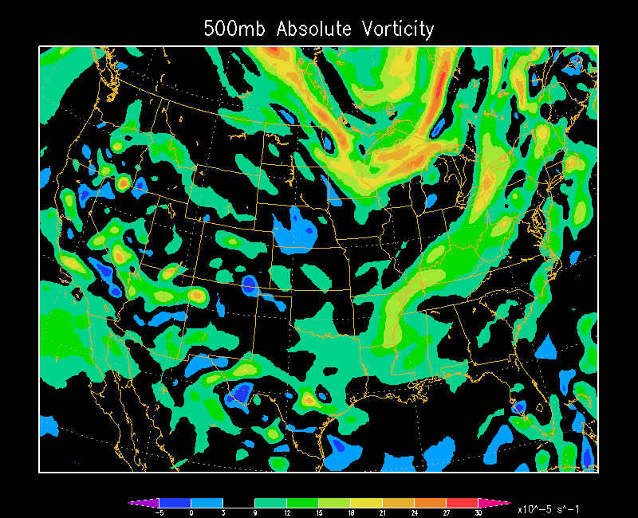
Absolute Vorticity

Slide 14
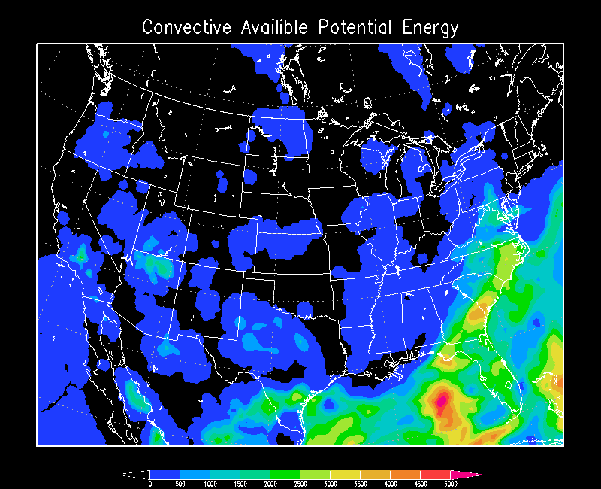
Convective Available Potential Energy

Slide 15
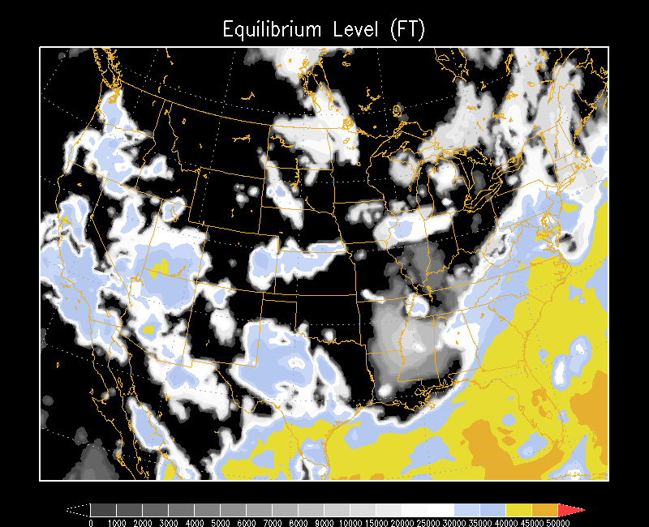
Equilibrium Level

Slide 16
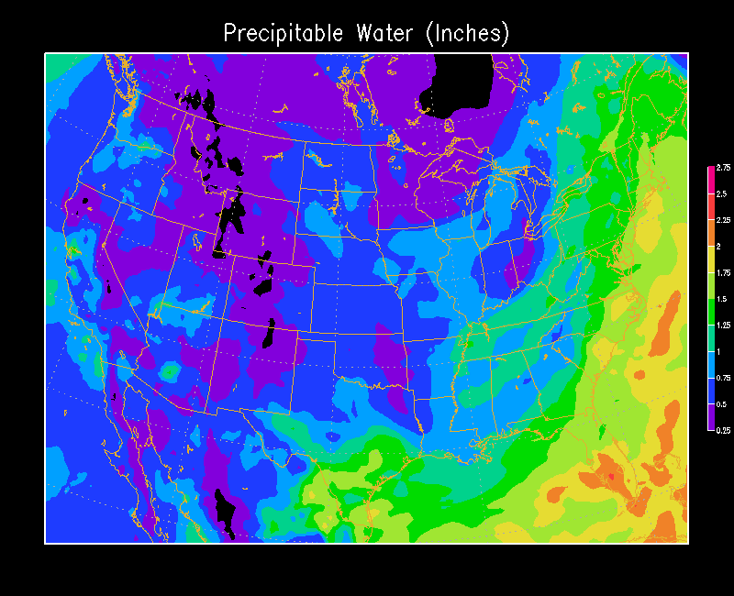
Precipitable Water

Slide 17
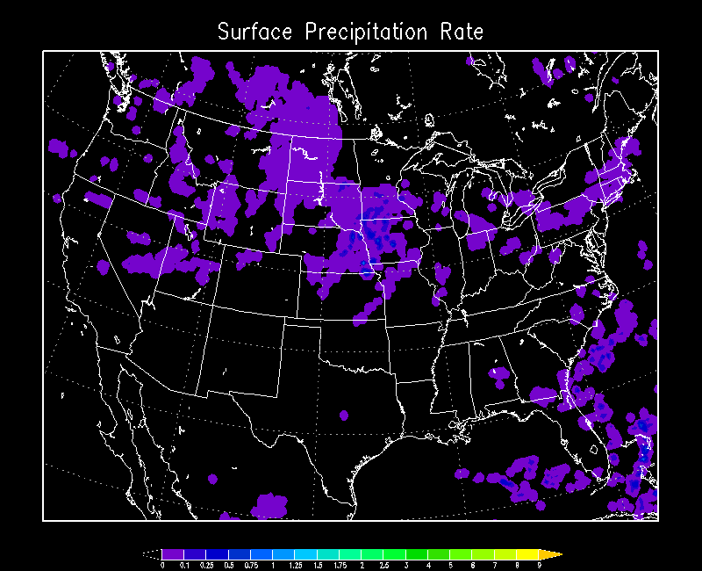
Precipitation Rate

Slide 18
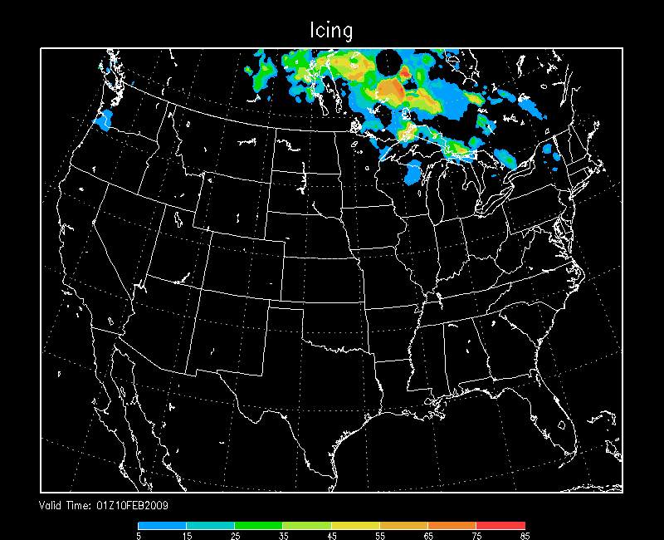
Icing

Slide 19
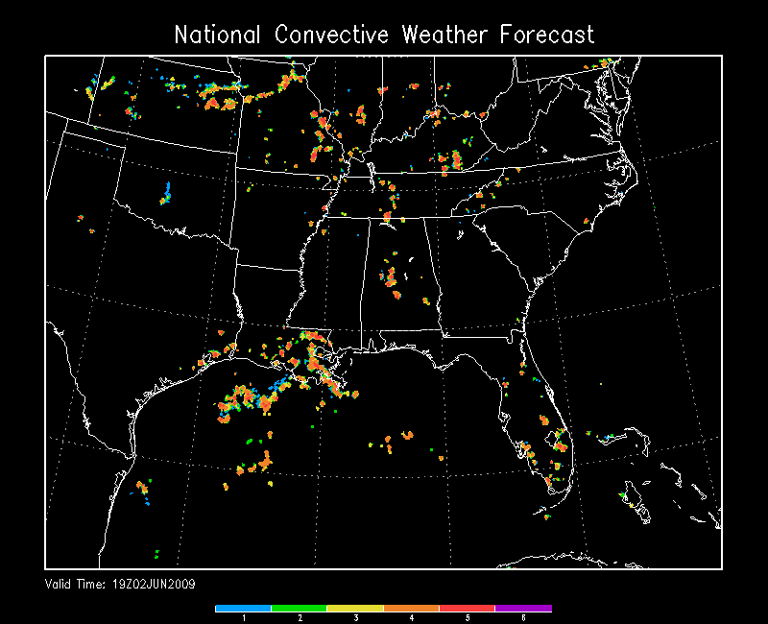
National Convective Weather Forecast

Slide 20
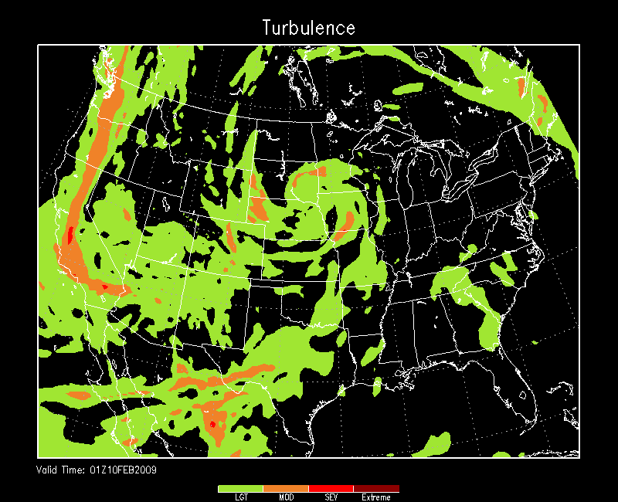
Graphical Turbulence Guidance

Slide 21
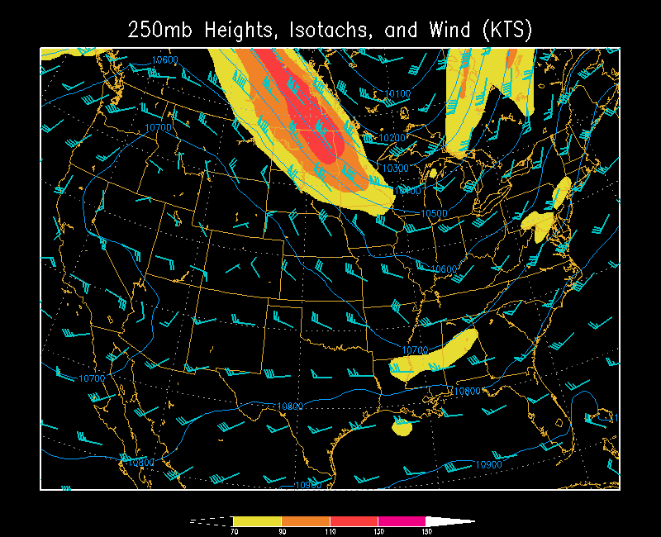
Multi-parameter Plots

